Slide 1


WELCOME
TEAM : 01

Slide 2

Women Empowerment
ASP.NET Core MVC

Slide 3

TEAM MEMBERS:
Malik Rehan Karol
Nargis Metkari
Shivani Bhavsar
Satyam
Km Priyanka
Vaishali Sharma
Gauri Deo

Slide 4

WHAT IS WOMEN EMPOWERMENT?
Women Empowerment refers to the activities undertaken to improve the social, economic, and political status of women in the world.
It means granting women the freedom to make life choices.
The female gender has faced subjugation and systematic oppression throughout history, and the situations call for improvement in their condition in society.

Slide 5
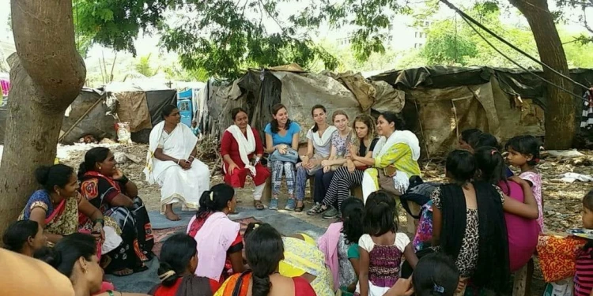
OBJECTIVES
Women will become self-confident, self-conscious and will acquire self-dignity through education.
Through women education illiteracy can be eradicated from the country.
Women will become conscious about their rights in different fields and skills to do different jobs and thus contribute directly to the society.

Slide 6
NEED OF WOMEN EMPOWERMENT
“Women are worshiped as goddess in India, but not given her true position”.
Women are deprived of:
-Decision making power
-Freedom of movement
-Access to Education
-Access to Employment
-Exposure to Media
-Domestic Violence

Slide 7
TECHNOLOGY & MODULES
Technology:
Module:
ASP.NET Core MVC
MS SQL
ADO.NET
EF-DB First Approach
WEP APIs
Admin Module
NGOs Module
STEP Module

Slide 8

Admin Module
Admin has top level permissions of the site-
Admin can see all the details of the Womens.
Admin can approve or reject Womens details.
Admin can see all the list of NGOs ,Steps in it.

Slide 9

NGOs Module
NGOs can be register theirselves and login to the portal.
There are some criteria to be registered.
We can see the list, status of organizations and FAQs.
There is also a funding norms.

Slide 10


STEP Module
STEP is Support to Training and Employment Programme.
Womens can register herself and login in their account.
Womens can check the guidelines here.
Womens can enroll in training courses and see the status of it.
Womens can see the list of NGOs.

Slide 11
CONSTRAINTS IN WOMEN EMPOWERMENT
Lack of education
Traditional view limit participation
Financial constraints
Family responsibilities
Low Mobility
Low ability to bear risk
Low social status
Conflicts among women’s groups

Slide 12
CHANGES OF AN EMPOWERED WOMEN
Improve personal knowledge
Self-defining power
Authenticity
Creativity
Physical strength
Equality
Economic independence
Having political power in society

Slide 13
ACTS FOR WOMEN EMPOWERMENT
Hindu Widows Remarriage Act,1856
Indian Penal Code,1860
Indian Evidence Act,1872
Hindu Marriage Act,1955
Dowery Prohibition Act
Maternity benefit Act ,1961
Domestic Violence Act,2005

Slide 14
PROGRAMMES/SCHEMES FOR WOMEN EMPOWERMENT
Beti Bachao Beti Padhao Scheme(22 jan,2015)
Ujjawala (Dec,2007)
Working Women Hostel (Introduced in 1972-73 and after amendment re-launched on 6 April 2017)
Support to Training & Employment Programme for women (STEP),(launched in 2003-04 and revised in Dec 2014)

Slide 15
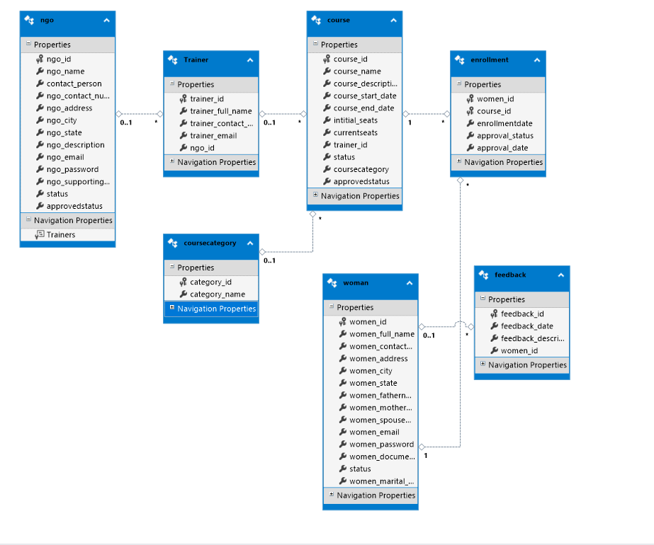
DATABASE

Slide 16
CONCLUSION
Women represent half of the world’s population and gender inequality exists in every nation on the planet.
The greatest need of the hour is change of social attitude to women.
The dream of women empowerment shall not be fulfil unless they are are empowered to play equal decisive and appropriate role in the family ,which is the basic unit of empowerment.

Slide 17
REFERENCES
Department of Women and Child Development , govt.of Haryana ,wcdhry.gov.in/SWAYAMSIDHA
Women in India-Wikipedia en.wikipedia.org/wiki/Women_in_india
www.indiastand.com/articles/the-power-of -pink

Slide 18
ANY
Question?

Slide 19

THE END
Thank YOU!

